Slide 1


Slide 2

Katalon Studio

Slide 3
Agenda:
Katalon Studio Overview
Katalon Uniqueness
Katalon Studio Overview
Automation Authoring
Competitors Analysis
Q&A

Slide 4

Katalon Studio Overview
Katalon Studio is a Simple and Powerful test automation solution for Mobile, Web, and API testing
Simple deployment, easy kick-off with project templates and hundreds of keywords built-in.
Cross platforms support Windows, MacOS, Linux and popular mobile and browser platforms.
Full featured to support small to enterprise automation teams
User friendly GUI, quick learning curve.
Detailed guides, tutorials and videos by the team and community.

Slide 5
Katalon Uniqueness
The Only Free -Full features automation solution available.
Dual scripting modes enable effective collaboration between manual tester to automation engineers.
Based on Selenium and Appium, the dominant automation stacks with official support for all browsers.
Native integrations with DevOps and CI/CD ecosystems: GIT, Jenkins, qTest, JIRA, Slack and major cloud services.
100% customer support satisfaction and positive net promoter score.

Slide 6
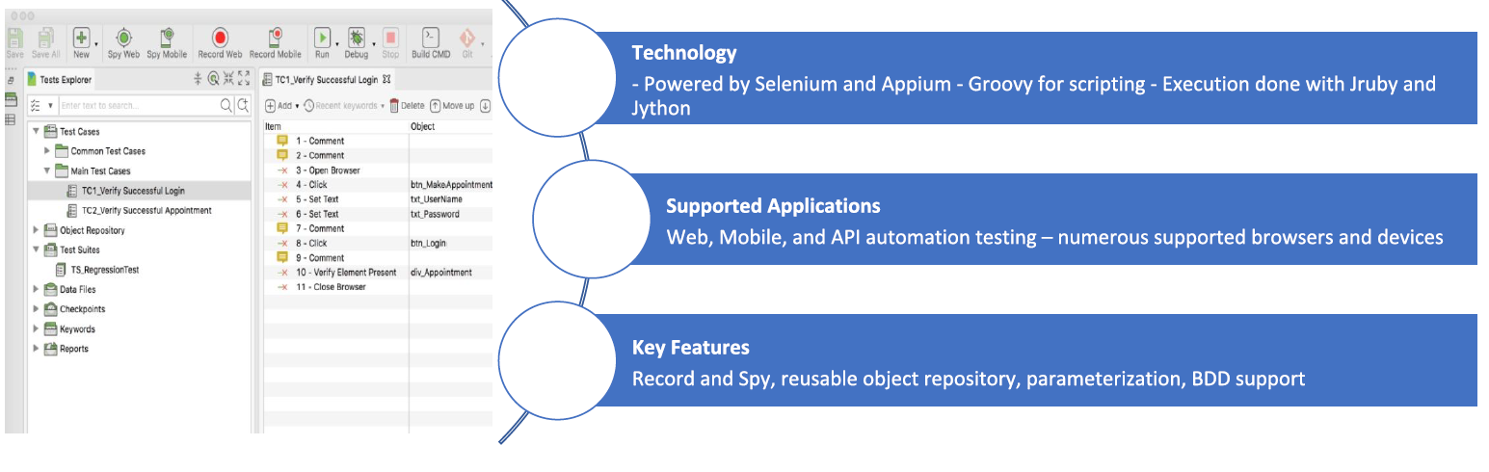

Slide 7
Automation Authoring
Test structure management (multi folders / modules structure).
Object spy, supporting OS components related to browsers’ activities.
Objects structure repository.
Test recording, auto script generating.
Prebuild keywords, validation methods.
Correlated scripting IDE & Editing interface to manipulate test scripts.
Define assertion, test-flow condition, variable.
External data sources: Excel, CSV, DB.
Script debugging.

Slide 8
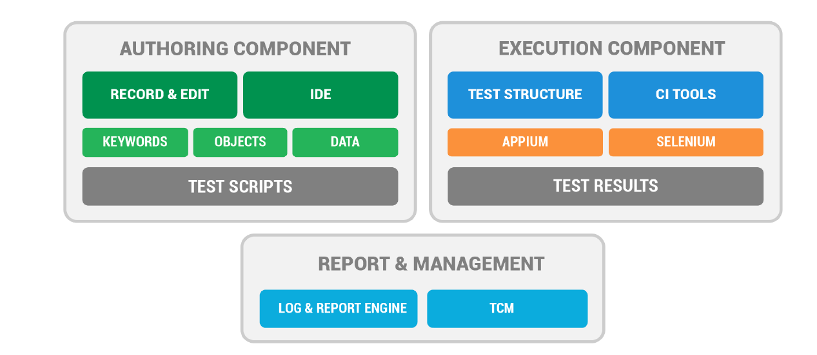

Slide 9
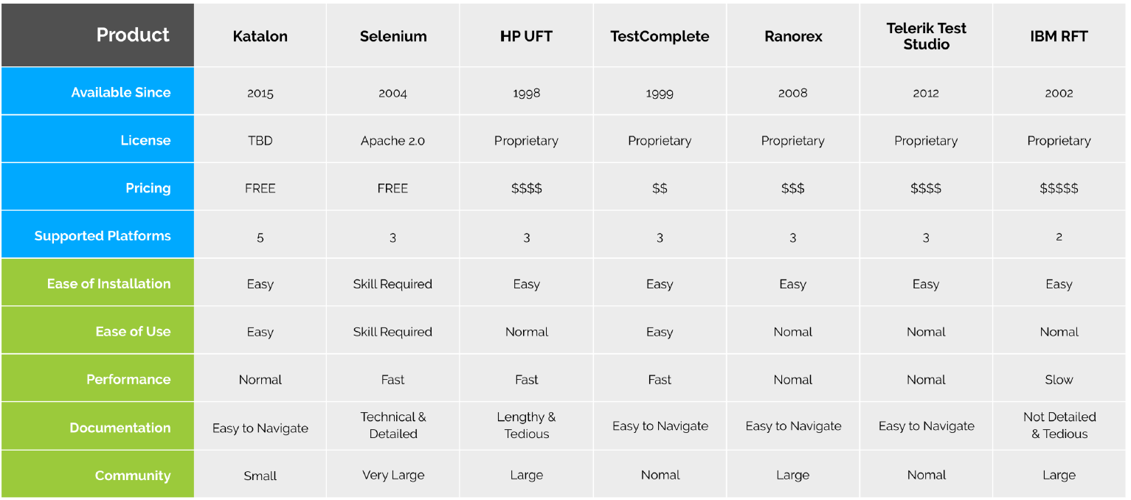
Competitors Analysis

Slide 10
Q & A

Slide 11
T H A N K Y O U !

